Slide 1
Tensorflow
An Introduction
Gene Olafsen

Slide 2
AI, ML Beginnings
LISP
The OG of AI languages
Symbolics and Lisp Machines – ran LISP natively
Python
Has been the language / platform of choice for machine learning for many years.

Slide 3
theano
Theano an academic project and is the inspiration for TensorFlow.
Theano is a Python library that lets you to define, optimize, and evaluate mathematical expressions, especially ones with multi-dimensional arrays (numpy.ndarray).
Release of Theano 1.0.0. -- November 2017
Theano announced that it has stopped development with the release of 1.0.0

Slide 4
Google Brain
Google Brain is a deep learning artificial intelligence research project at Google.
Combines:
Open-ended machine learning research
System engineering
Google-scale computing resources.

Slide 5
Distbelief
TensorFlow is Google Brain's second-generation machine learning technology.
DistBelief is Google Brain's first machine learning system.
Built using proprietary algorithms implementing deep learning neural networks.
Backpropagation was later introduced, significantly enhancing the neural network performance.

Slide 6
What's in a name?
Tensor – refers to multidimensional data arrays.
Flow – flow refers to a computational graph or the route of tensor operations.
When the tensors are passed around, their values and shapes are updated by the graph operations.

Slide 7
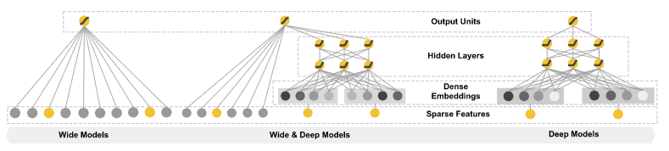
Wide and deep learning
Deep Learning is used when machine learning datasets are large and the target function is complex.
Deep learning automatically select the features and assign the weights.

Slide 8
licensing
Tensorflow is google backed and designed to operate on highly distributed systems.
Version 1.0.0 was released on February 11, 2017
Licensed under the Apache License, Version 2.0

Slide 9
Tensorflow API
Low level API 'TensorFlow Core- provides complete programming control. It is recommend for machine learning researchers and others who require fine levels of control over their models.
The higher level APIs are built on top of TensorFlow Core. These higher level APIs are typically easier to learn and use than TensorFlow Core. In addition, the higher level APIs make repetitive tasks easier and more consistent.
For example: A high-level API like tf.estimator helps manage data sets, estimators, training and inference.

Slide 10
Tpu – tensorflow processing unit
Tensorflow Processing Unit (TPU) -- an ASIC built specifically for machine learning and tailored for TensorFlow.
TPU is a programmable AI accelerator
Designed to provide high throughput of low-precision arithmetic
Utilized for running models rather than training them.

Slide 11
Tpu v2
The second-generation TPUs deliver up to 180 teraflops of performance, and when organized into clusters of 64 TPUs, provide up to 11.5 petaflops.

Slide 12
packaging
The downloadable Tensorflow package supports both GPU and non-GPU enabled calculation. Graphic Processor Units, such as those produced by NVidia excel at the matrix operations on which Tensorflow relies.
Note: AMD offers a new line of EPYX-architecture processors which will support TensorFlow. (TensorFlow is not supported on legacy processors.)

Slide 13
Gce – google compute engine
TensorFlow is hosted by GCE
Google Compute Engine (GCE) is the Infrastructure as a Service (IaaS) component of Google Cloud Platform which is built on the global infrastructure that runs Google’s search engine, Gmail, YouTube and other services.
Google Compute Engine enables users to launch virtual machines (VMs) on demand.

Slide 14
Tensorflow at scale
TensorFlow can distribute processing across CPU cores, GPU cores, or even multiple devices like multiple GPUs.
There is a performance cost associated with the distribution of tensors across multiple processors and/or machines. Tensorflow addresses the performance impact of moving tensor (data) around the system by employing a lossy compression algorithm. 32-bit and 64-bit floating point numbers are reduced to 16-bit resolution.

Slide 15
Tensorflow lite
In May 2017 Google announced a software stack specifically for Android development.
TensorFlow Lite supports a set of core operators, both quantized and float, which have been tuned for mobile platforms.
Enables on-device machine learning inference with low latency and a small binary size.
TensorFlow Lite also supports hardware acceleration with the Android Neural Networks API.

Slide 16
installation
You can install Tensorflow using pip using the following command:
pip install tensorflow
Or if you have a GPU:
pip install tensorflow-gpu
Note that if you're installing the GPU version, you need to have CUDA and cuDNN installed. (next slide)

Slide 17
cuda
CUDA® is a parallel computing platform and programming model developed by NVIDIA for general computing on graphical processing units (GPUs). With CUDA, developers are able to dramatically speed up computing applications by harnessing the power of GPUs.
The NVIDIA CUDA® Deep Neural Network library (cuDNN) is a GPU-accelerated library of primitives for deep neural networks. cuDNN provides highly tuned implementations for standard routines such as forward and backward convolution, pooling, normalization, and activation layers.
Text from NVIDIA website

Slide 18
Device enumeration
# determine the devices available to tensorflow
import tensorflow as tf
from tensorflow.python.client import device_lib
print ([x.name for x in device_lib.list_local_devices()])
['/cpu:0', '/gpu:0']

Slide 19

Tensor

Slide 20
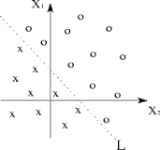
tensor
Tensors are multilinear maps.
A single variable is called a linear map.
Two variables are a bilinear map.
Many variables is called a k-linear map.
A Multilinear map is a function of several variables that is linear separately in each variable.
Linear Separability

Slide 21
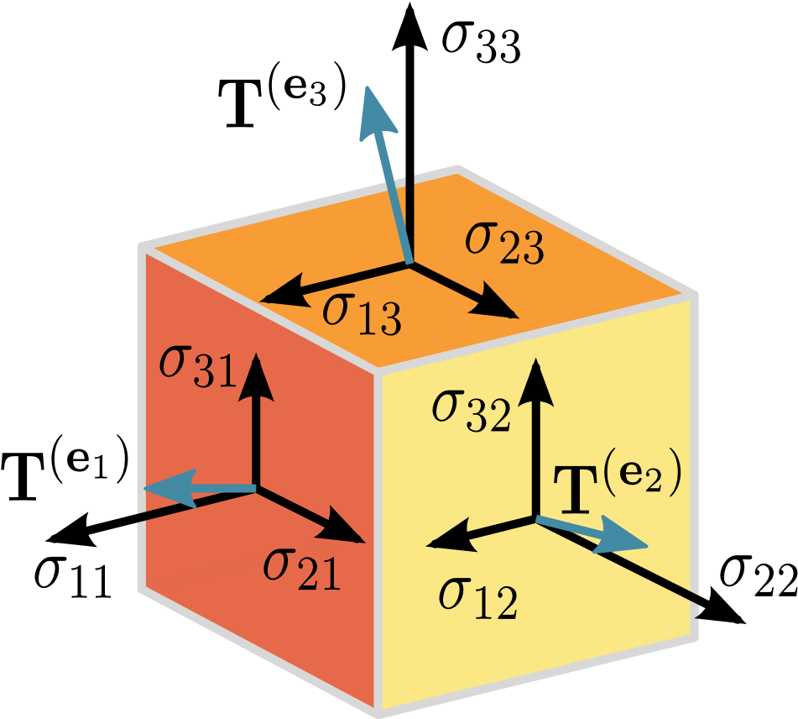
Tensor Visual
Tensor is a N-dimensional vector
https://towardsdatascience.com/a-beginner-introduction-to-tensorflow-part-1-6d139e038278

Slide 22
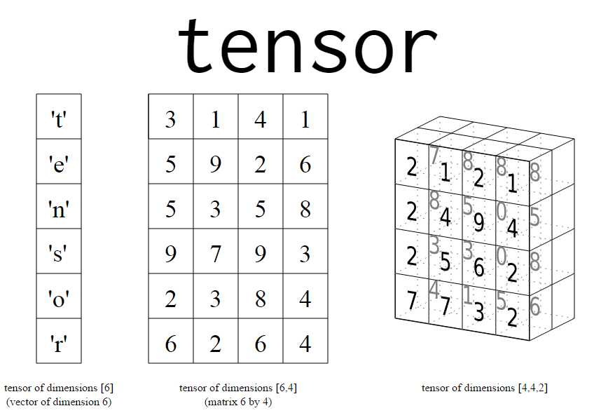
Tensor as an array of matrices
Simplified Tensors
Tensors can be thought of as an array of matrices or n-dimensional matrix.
Scalers – ordinary numbers: 1,2, 3.1415
Vector
Matrix
https://towardsdatascience.com/a-beginner-introduction-to-tensorflow-part-1-6d139e038278

Slide 23
Tensor as code
3 # a rank 0 tensor; a scalar with shape []
[1., 2., 3.] # a rank 1 tensor; a vector with shape [3]
[[1., 2., 3.], [4., 5., 6.]]
# a rank 2 tensor; a matrix with shape [2, 3]
[[[1., 2., 3.]], [[7., 8., 9.]]]
# a rank 3 tensor with shape [2, 1, 3]

Slide 24
Tensors... in tensorflow
In Tensorflow, there are three primary types of tensors:
tf.Variable
tf.constant
Tf.placeholder

Slide 25
Tf.Variable
A TensorFlow variable is the best way to represent shared, persistent state manipulated by your program.
TensorFlow variables are defined and initialized differently from standard Python variables- for the reason that TensorFlow can operate in a distributed environment.
my_variable = tf.get_variable("my_variable", [1, 2, 3])

Slide 26
Tf.constant
# Constant 1-D Tensor populated with value list.
tensor = tf.constant([1, 2, 3, 4, 5, 6, 7])
# Constant 2-D tensor populated with scalar value -1.
tensor = tf.constant(-1.0, shape=[2, 3]) => [[-1. -1. -1.]
[-1. -1. -1.]]

Slide 27
Tf.placeholder
Inserts a placeholder for a tensor that will be always fed.
Note: This tensor will produce an error if evaluated. Its value must be fed using the feed_dict optional argument to Session.run(), Tensor.eval(), or Operation.run()
x = tf.placeholder(tf.float32, shape=(1024, 1024))
y = tf.matmul(x, x)
with tf.Session() as sess:
print(sess.run(y)) # ERROR: will fail because x was not fed.
rand_array = np.random.rand(1024, 1024)
print(sess.run(y, feed_dict={x: rand_array})) # Will succeed.

Slide 28
Flow

Slide 29
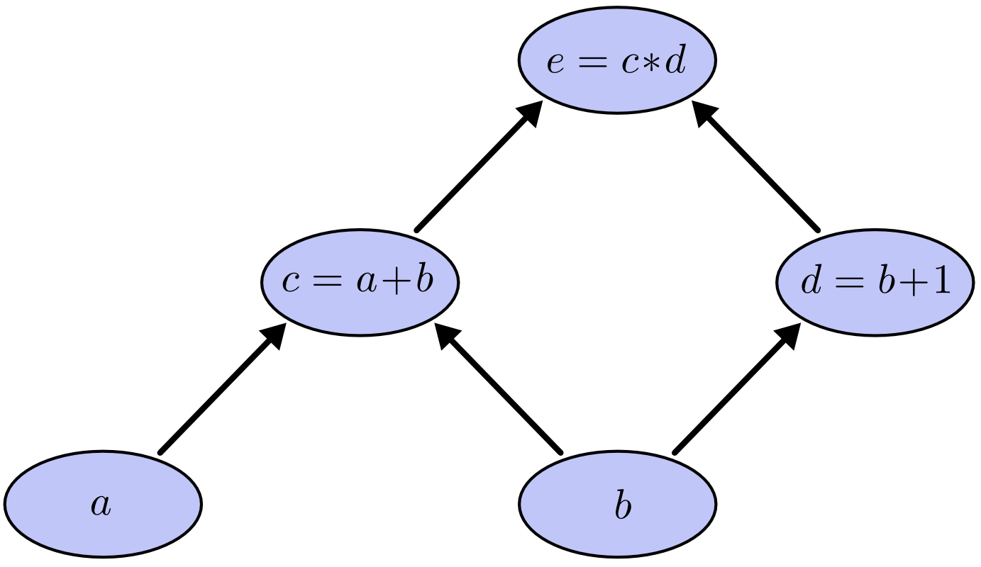
Computational graph
e = (a+b)*(b+1)
Graphic: https://towardsdatascience.com/a-beginner-introduction-to-tensorflow-part-1-6d139e038278

Slide 30
Computational Graphs and Subgraphs
A computational graph always represents a complex operation in hierarchical order.
Leaf vertices are always tensors.
Each operation in the graph should accept a tensor and produce a new tensor.
The operations contained in nodes at the same level are independent of one another- facilitating parallel execution. The operations performed on tensors at lower levels are considered subgraphs.

Slide 31
Define your first graph
import tensorflow as tf
x1 = tf.constant(7) # define a tensor node
x2 = tf.constant(8) # define a tensor node
result = tf.mul(x1,x2) # define an operation
print(result)

Slide 32
Execute your first graph
sess = tf.Session() # create a Python session variable
sess.run(result) # execute the graph
sess.close() # close context explicitly
with tf.Session() as sess: # open session context
output = sess.run(result) # execute graph
print(output) # display result

